Slide 1
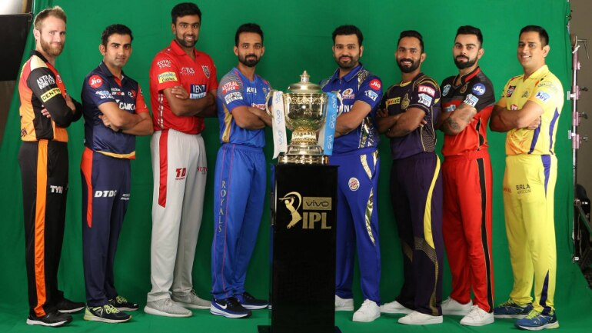

EDA ON IPL

Slide 2
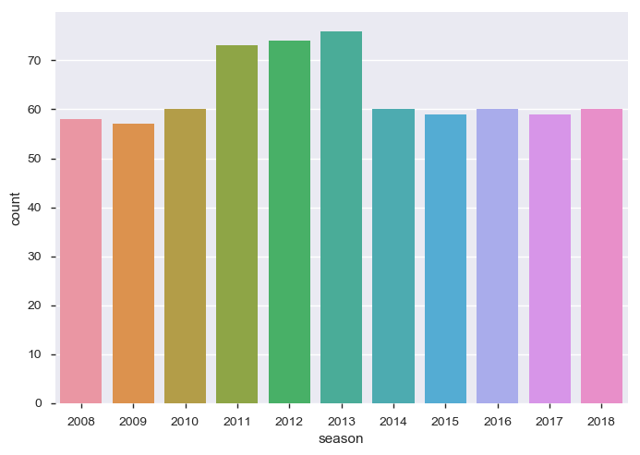
Season had most number of matches
As we can see, In 2013, highest number IPL matches were being played 70+ because there were many teams in year 2013. next highest matches were played in 2012 followed by 2011 and the least number of matches were played in 2009 since in that year it was IPL season 2 and was emerging.

Slide 3
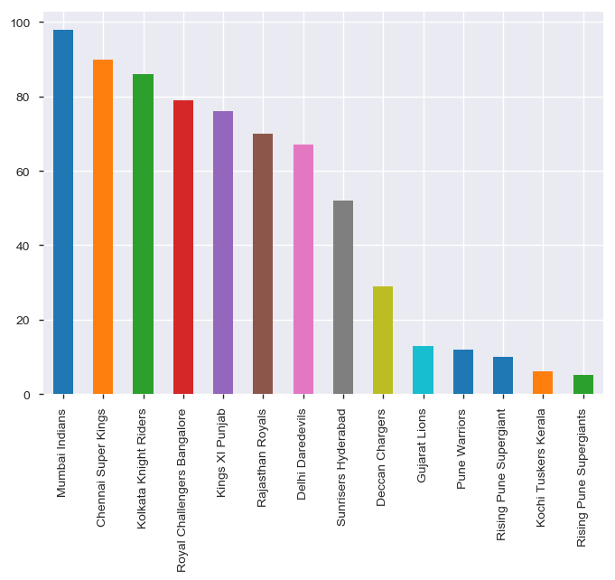
The most successful IPL Team of decade
The most successful IPL team is the team that has won most number of times. Mumbai Indians is the most successful IPL team since a decade and not much performing team is Rising Pune supergiants.

Slide 4
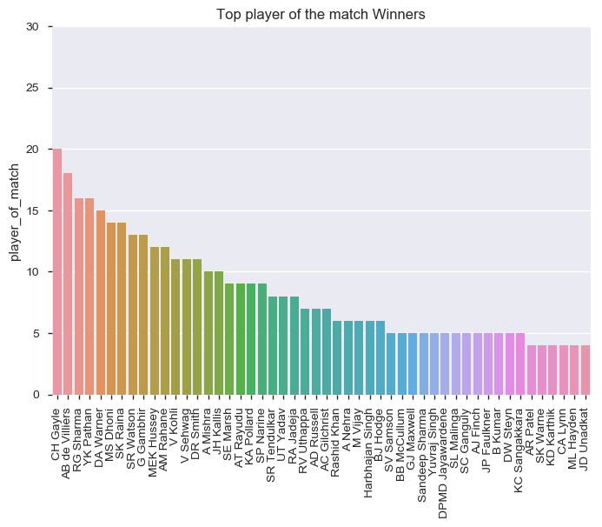
Match winners (player of match)
For those who follow IPL, you might have been wondering the irony now. Chris Gayle, is the most successful IPL player, wasn’t sold in the first round.

Slide 5
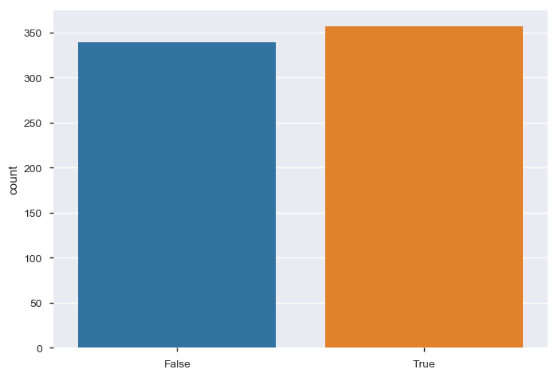
How many Toss winning teams have won the matches
Toss winning actually helps in Match winning — or to be statistically right, we could say there’s a correlation between Toss Winning and Match Winning and so we can assume that it helps.

Slide 6
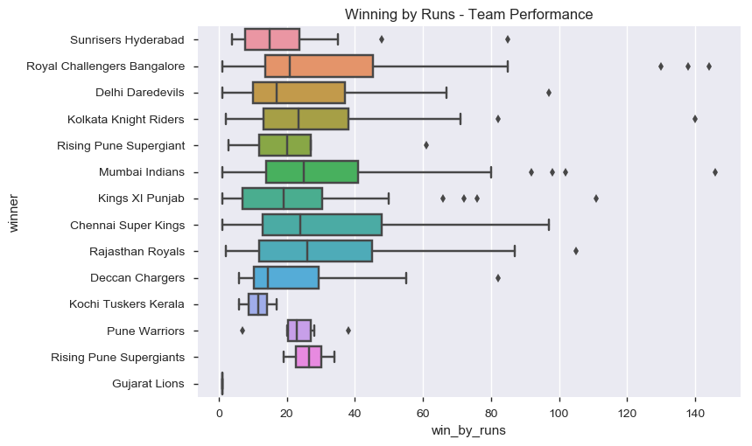
Teams won by the runs as a bar plot
RCB and Mumbai Indians have won most of matches by scoring huge runs. Gujarat lions were the least scorer in the IPL matches. There were some matches by most of teams with nail biting finishes by just 1to 5 runs range.

Slide 7
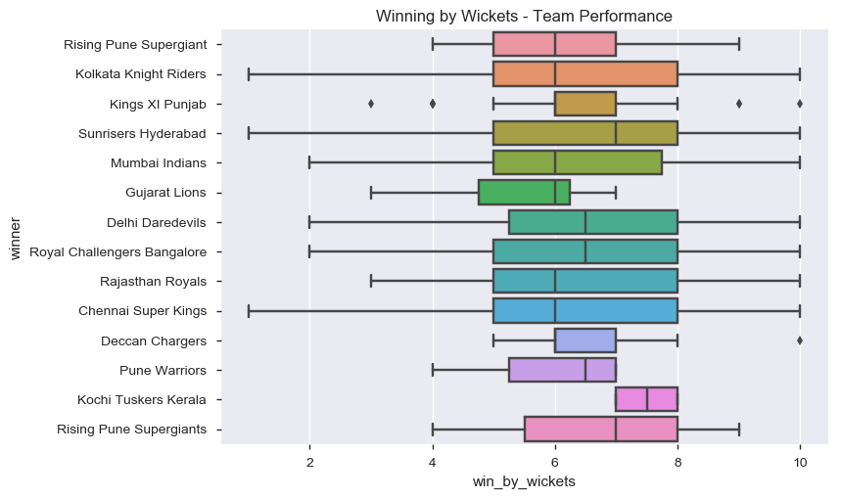
Teams won by the wickets as a bar plot
most of the teams have won matches by batting second. The matches won by KKR, SRH, MI, DD,RCB,CSK, RR have won matches without any loss of wickets.
there were some matches with nail biting finishes (won by just 1 wicket) by KKR, SRH, CSK.

